Slide 1



BUILDING
RECOMMENDATION
ENGINES
WITH SPRING

Slide 2


MICHAEL MINELLA
TWITTER: @MICHAELMINELLA
HOME PAGE: SPRING.IO/TEAM/MMINELLA
OFFICE HOURS: 1:40 pm TODAY!

Slide 3


http://github.com/mminella/RecommendationEngine

Slide 4


Slide 5
11
14
7
12
20
16
5
17
6
3
2
8
18
13
4
1
10
19
23
15
9

Slide 6


Notes:
Look at the site we’ll update
Also look at the technologies we’ll use

Slide 7

RECOMMENDATION
ALGORITHMS

Slide 8

/**
* @author Michael Minella
*/
@Configuration
@ComponentScan
@EnableAutoConfiguration
public class Application {
@Bean
ItemBasedRecommender recommender(DataSource dataSource) {
DataModel dataModel = new MySQLBooleanPrefJDBCDataModel(dataSource);
ItemSimilarity similarity = new MySQLJDBCItemSimilarity(dataSource);
AllSimilarItemsCandidateItemsStrategy candidateItemsStrategy =
new AllSimilarItemsCandidateItemsStrategy(similarity);
return new GenericItemBasedRecommender(dataModel, similarity, candidateItemsStrategy, candidateItemsStrategy);
}
public static void main(String[] args) {
SpringApplication.run(Application.class, args);
}
}

Slide 10
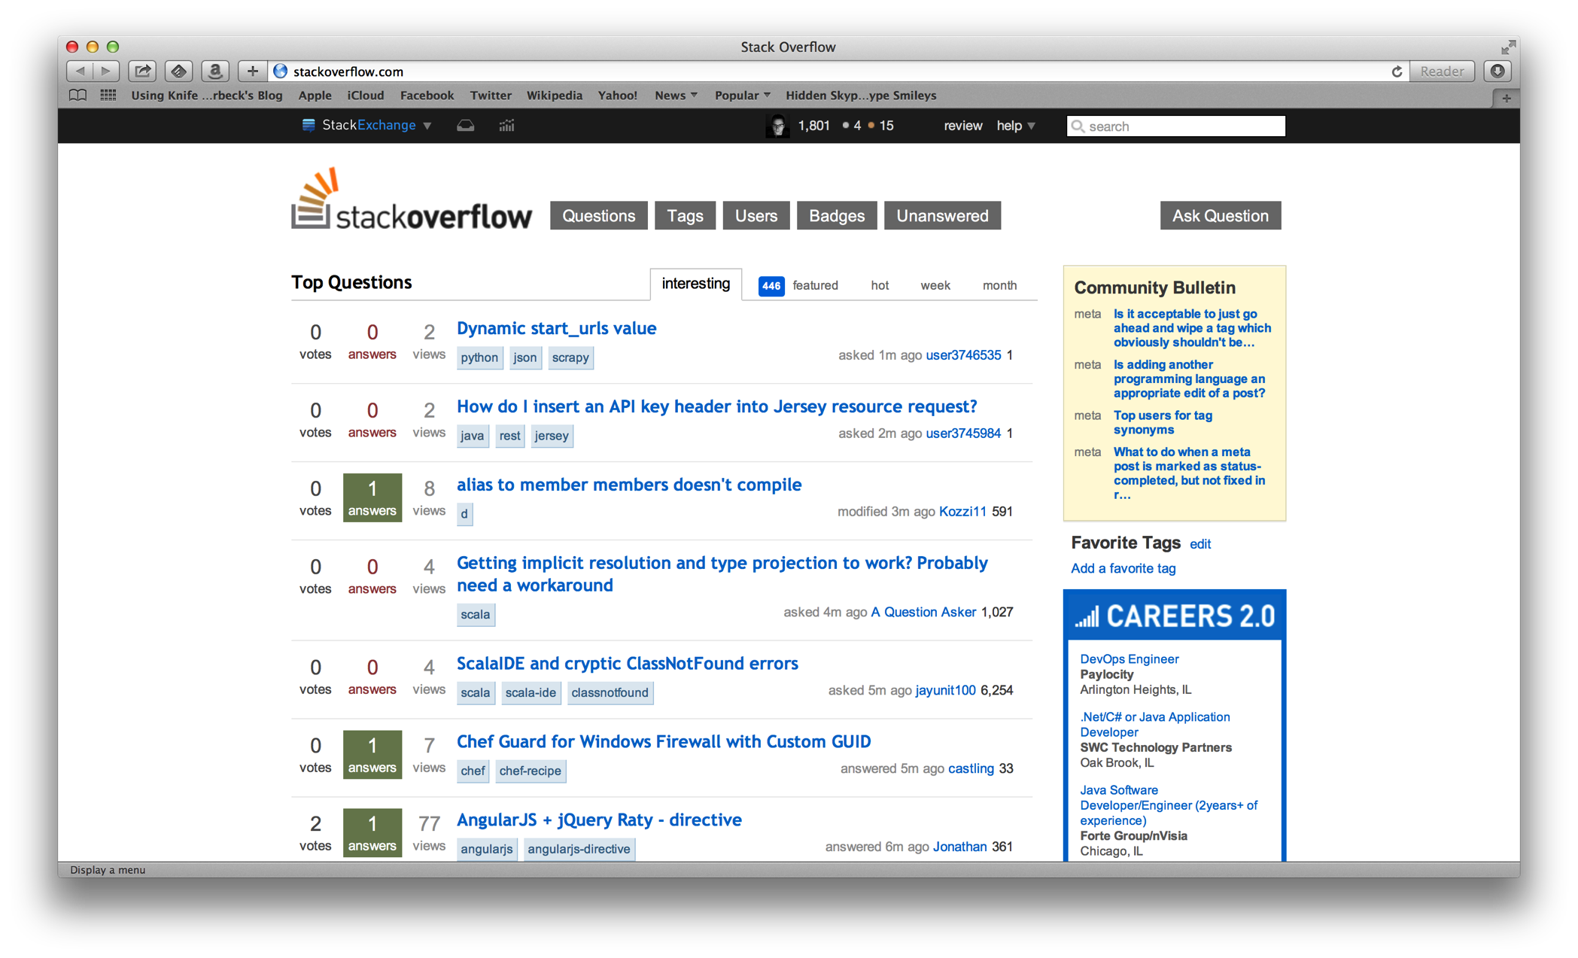

Slide 11
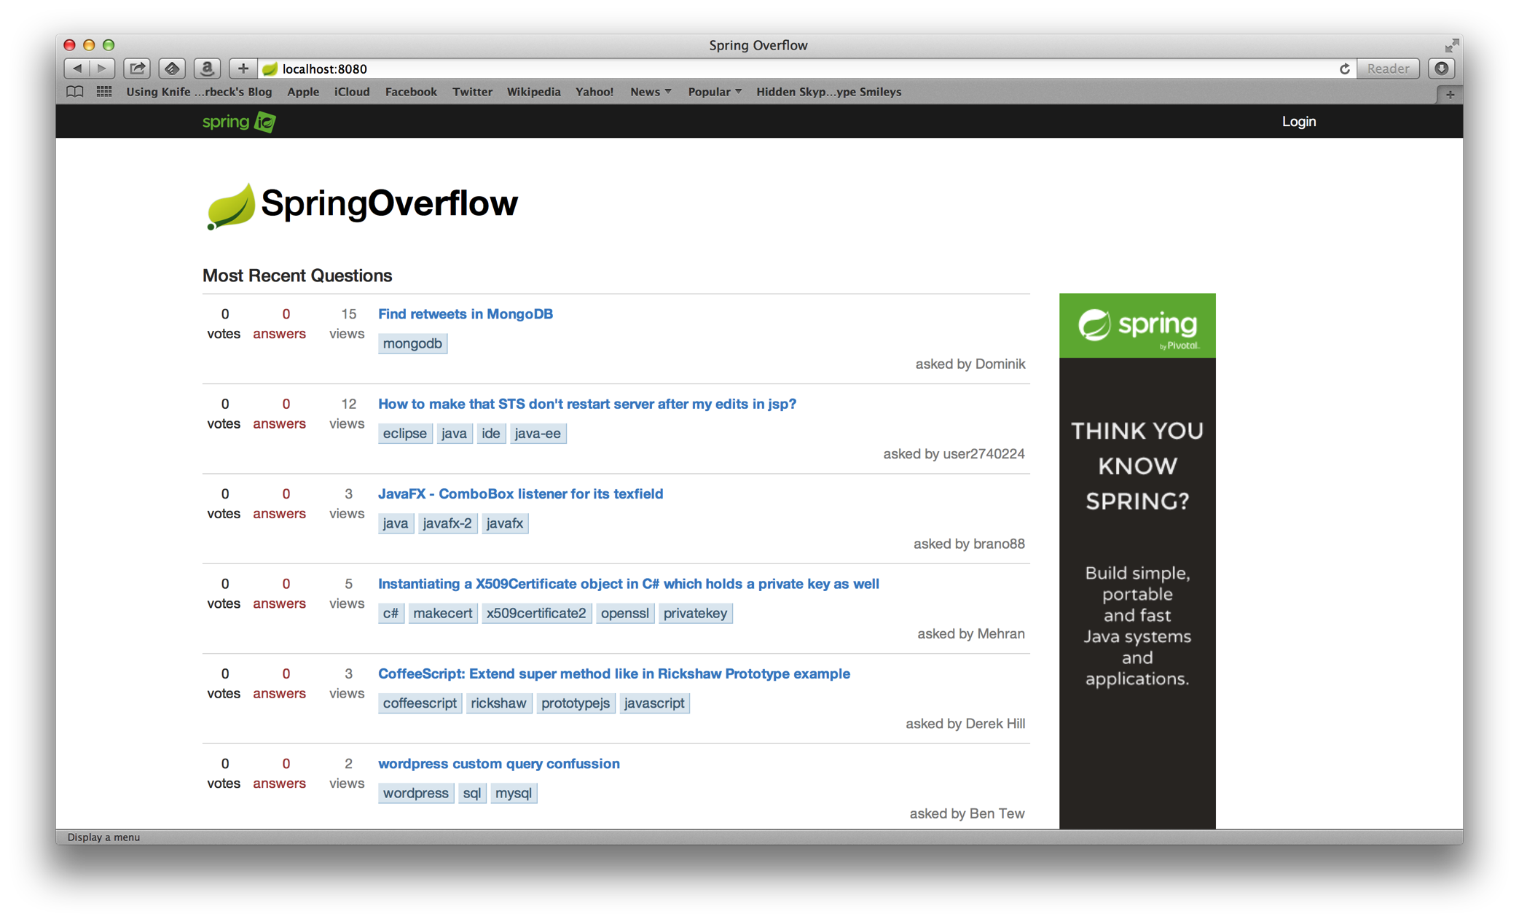

Slide 12
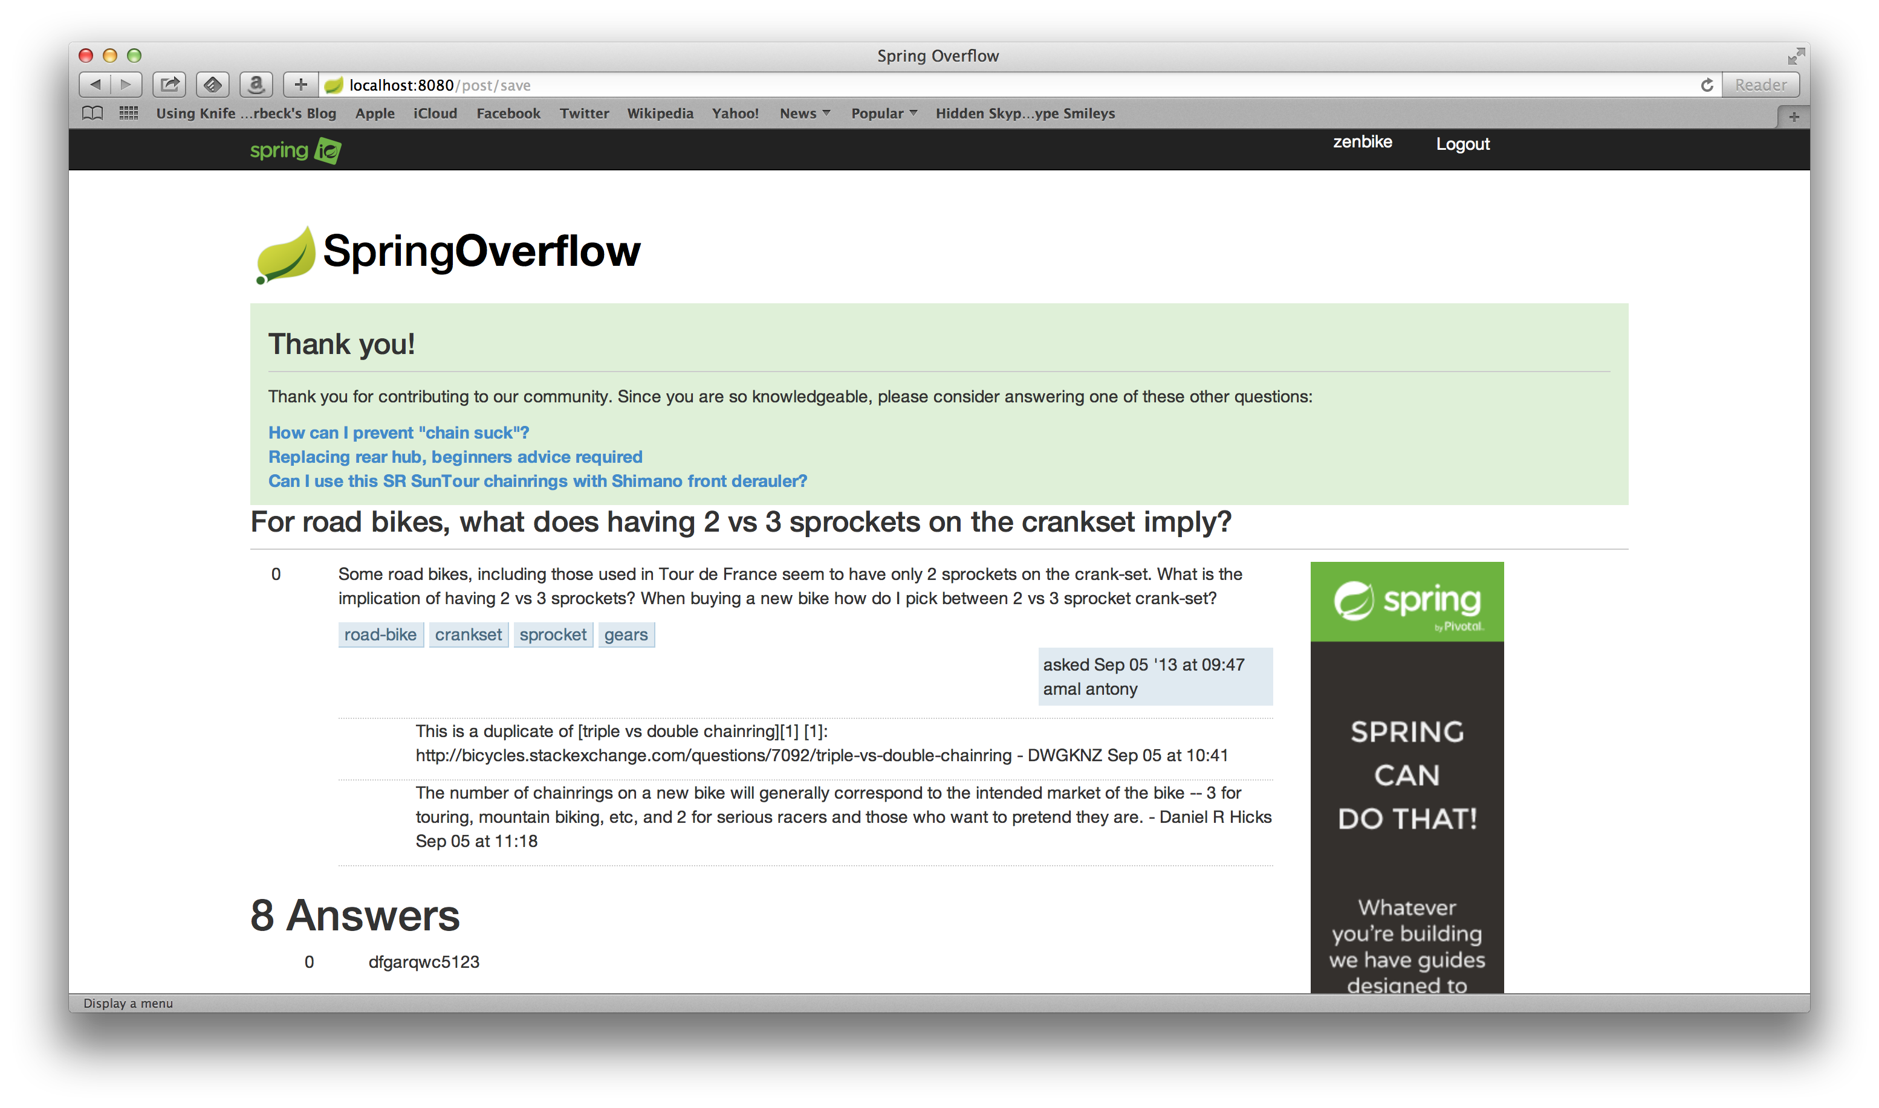

Slide 13
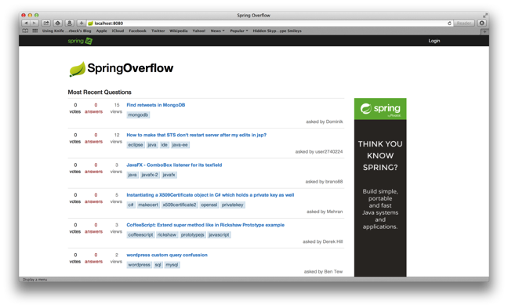



Notes:
Spring XD handles everything in the circle

Slide 14

TOOLS AND
TECHNOLOGIES

Slide 15
1
SPRING BOOT
Notes:
Spring Boot, Spring Data JPA, Spring Core/MVC, Spring Security,

Slide 16
2
MYSQL

Slide 17
3
HADOOP

Slide 18
4
SPRING XD

Slide 19
5
MAHOUT

Slide 20

SPRING XD
EXTREME DATA

Slide 21


APPLICATION
COMPLEXITY

Slide 22



LOTS OF
BOILERPLATE

Slide 23

MANY DOMAINS TO
BRIDGE

Slide 24






INCONSISTENT
APIS

Slide 25

SOURCE, CHANEL, SINK
DATA FLOW MODEL
=
ADAPTER, CHANEL, FILTER, TRANSFORMER, ETC
EIP PATTERNS

Slide 26
JOB, CONNECTOR
IMPORT/EXPORT
=
JOB, ITEMREADER/ITEMWRITER
BATCH PROCESSING

Slide 27
WORKFLOW, ACTION
WORKFLOW
ORCHESTRATION
=
JOB, STEP
BATCH PROCESSING

Slide 28
SPRING XD
EXTREME DATA

Slide 29

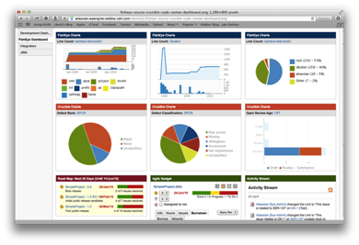





Ingestion
Orchestration
SPRING
Extraction
Real-time
Analytics
Notes:
Spring XD handles everything in the circle

Slide 30

DISTRIBUTED
RUNTIME

Slide 31
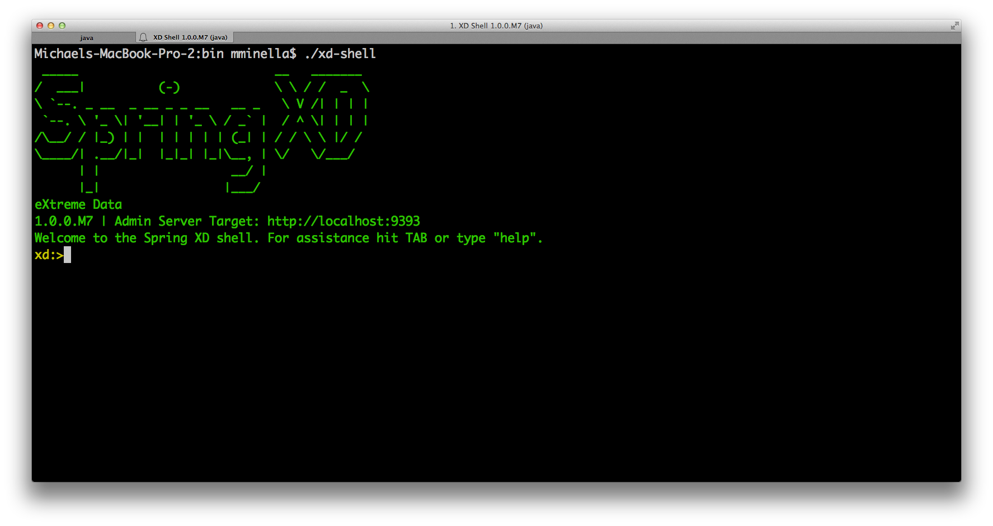

Slide 32
http
|
hdfs
--directory=/xd/dir1
--port=8181
filter --expression=“payload?.price > 3.00” |

Slide 33


Slide 34

TOTAL LINES OF CUSTOM CODE
47 Lines of Java
29 Lines of XML
6 Spring XD Shell Commands

Slide 35
RECOMMENDATION
ALGORITHMS

Slide 36

COLLABORATIVE
FILTERING

Slide 37

TWO OPTIONS

Slide 38

USER BASED
Notes:
Compare users. Determine what users exhibit the same patterns as the current user.

Slide 39




ITEM BASED
Notes:
Invented by Amazon (you bought X…you may be interested in Y)
Item Based scales better (a function of your catalog, not your customer base)
Item Based doesn’t need to be updated as frequently

Slide 40
PEOPLE ARE
FUNNY

Slide 41
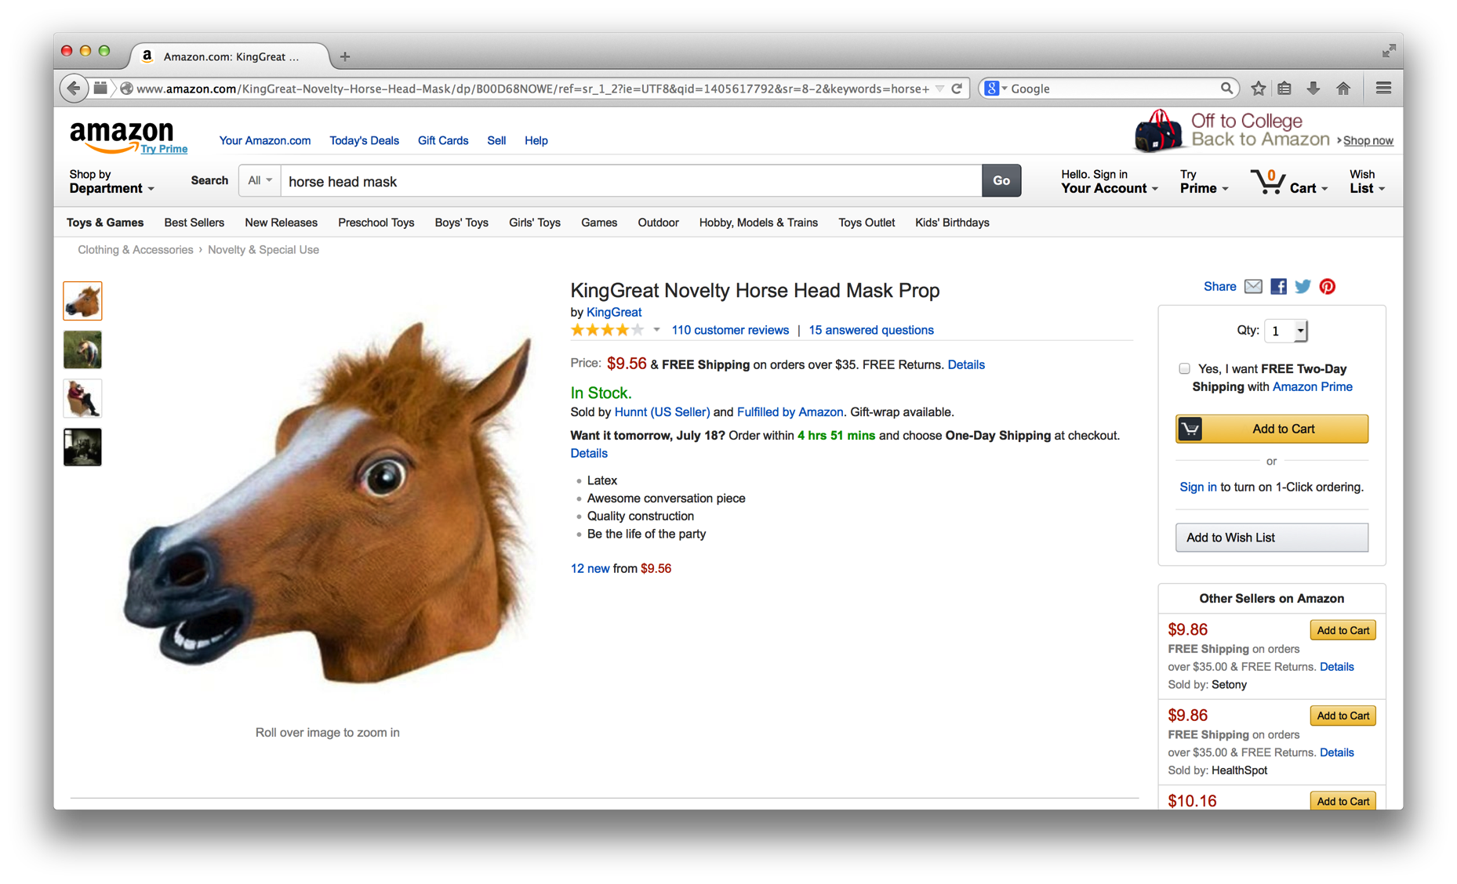

Slide 42
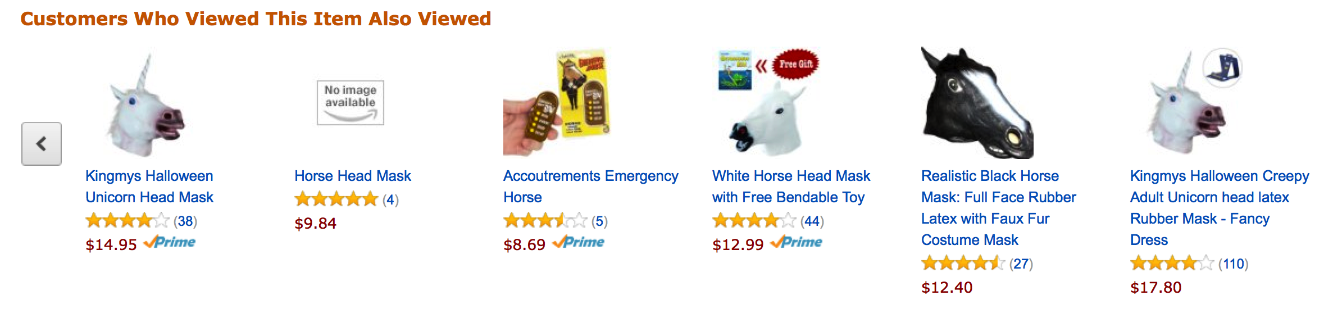
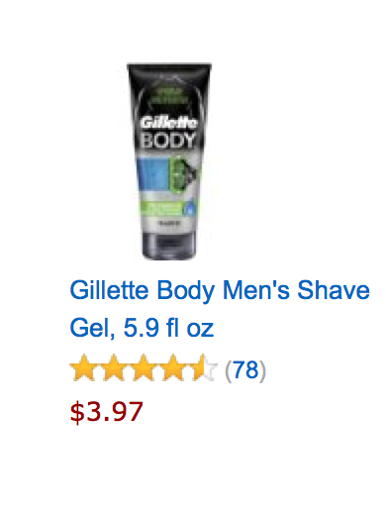


Slide 43
/**
* @author Michael Minella
*/
@Configuration
@ComponentScan
@EnableAutoConfiguration
public class Application {
@Bean
ItemBasedRecommender recommender(DataSource dataSource) {
DataModel dataModel = new MySQLBooleanPrefJDBCDataModel(dataSource);
ItemSimilarity similarity = new MySQLJDBCItemSimilarity(dataSource);
AllSimilarItemsCandidateItemsStrategy candidateItemsStrategy =
new AllSimilarItemsCandidateItemsStrategy(similarity);
return new GenericItemBasedRecommender(dataModel, similarity, candidateItemsStrategy, candidateItemsStrategy);
}
public static void main(String[] args) {
SpringApplication.run(Application.class, args);
}
}

Slide 44
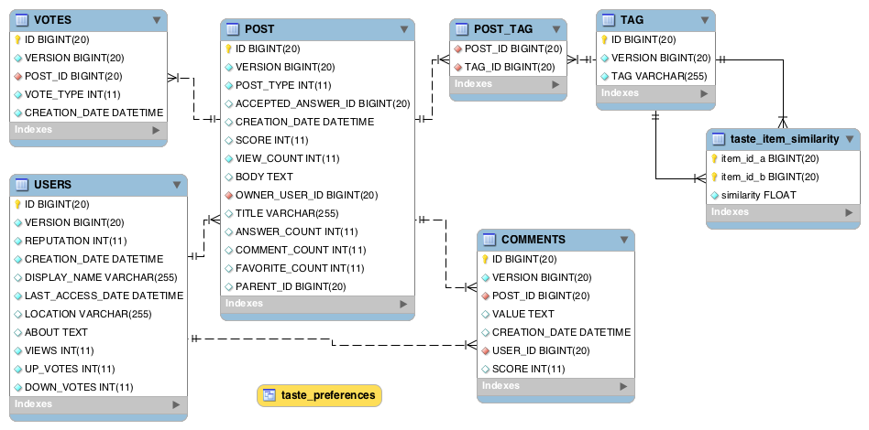

Slide 45
Notes:
File in HDFS with following format:
userId, tagid, score
Results from Mahout job
tagId, tagId, score

Slide 46


Slide 47

The
End

Slide 48

Learn More. Stay Connected.
Twitter: twitter.com/springcentral
YouTube: spring.io/video
LinkedIn: spring.io/linkedin
Google Plus: spring.io/gplus
Spring Batch
Project: spring.io/spring-batch
Github: github.com/spring-projects/spring-batch
Jira: jira.spring.io/browse/BATCH
Spring Boot
Project: spring.io/spring-boot
Github: github.com/spring-projects/spring-boot
Spring XD
Project: spring.io/spring-xd
Github: github.com/spring-projects/spring-xd
Jira: jira.spring.io/browse/XD

Slide 49












Increase by Attilio Baghino from
The Noun Project
Question by Jessica Lock from
The Noun Project
Servers by Jaime Carrion from
The Noun Project
Twitter by Maria Maldonado from
The Noun Project
Running by Dillon Arloff from
The Noun Project
Syringe by Gilad Fried from
The Noun Project
List by Agus Purwanto from
The Noun Project
Arrows by Juan Pablo Bravo from
The Noun Project
Tank by Renan Ferreira Santos from
The Noun Project
Hammock by Adam Mullin from
The Noun Project
Architect by Luis Prado from
The Noun Project
Database by Anton Outkine from
The Noun Project

